Slide 1


Study in Seeds Data Set

Slide 2
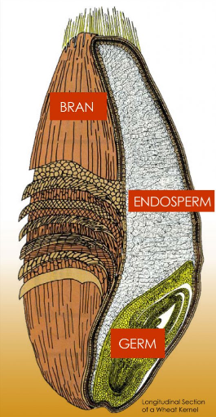
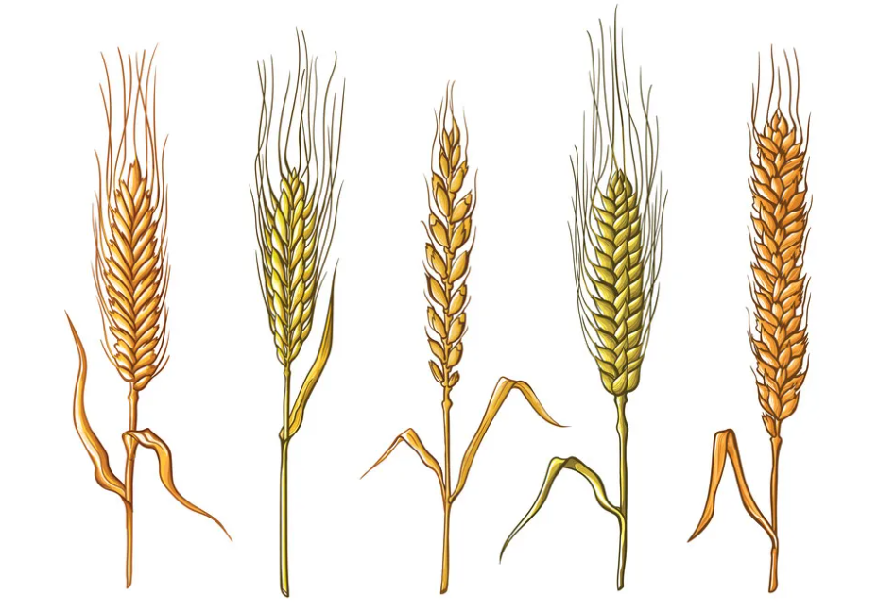

Slide 3
Content
1
Gather Data
2
Visualizing Data Analysis
3
Exploratory Data Analysis
4
Results and Analysis
5
Discussion

Slide 4

1
Gather Data
The dataset is from UCI ML data repository(https://archive.ics.uci.edu/ml/datasets/seeds).
Measurements of geometrical properties of kernels belonging to three different varieties of wheat. A soft X-ray technique and GRAINS package were used to construct all seven, real-valued attributes.

Slide 5
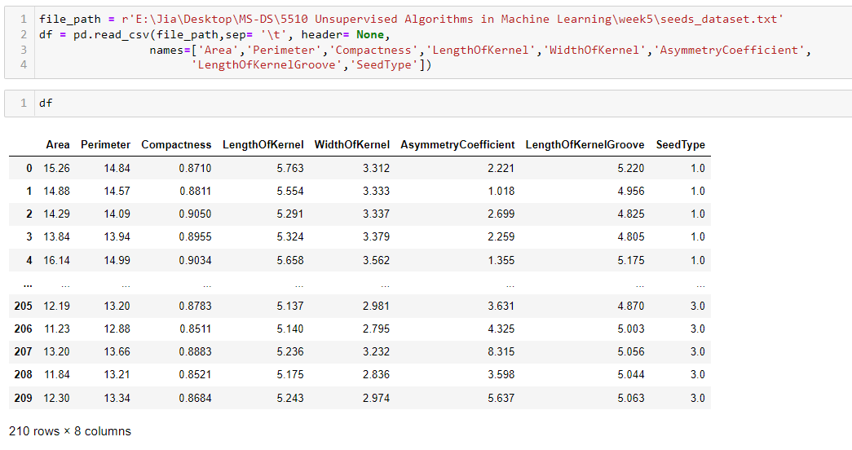
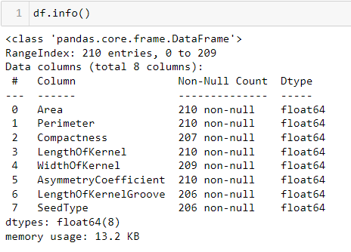
1.1 Import data

Slide 6
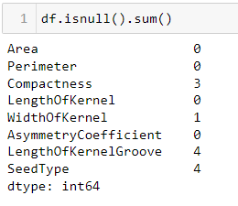
1.2 Inspect null values
Complete case analysis is to drop any observations (rows) that have null values. It is suitable if the number of observations with null values are very small (say, less than 5%) compared to the total number of observations.

Slide 7
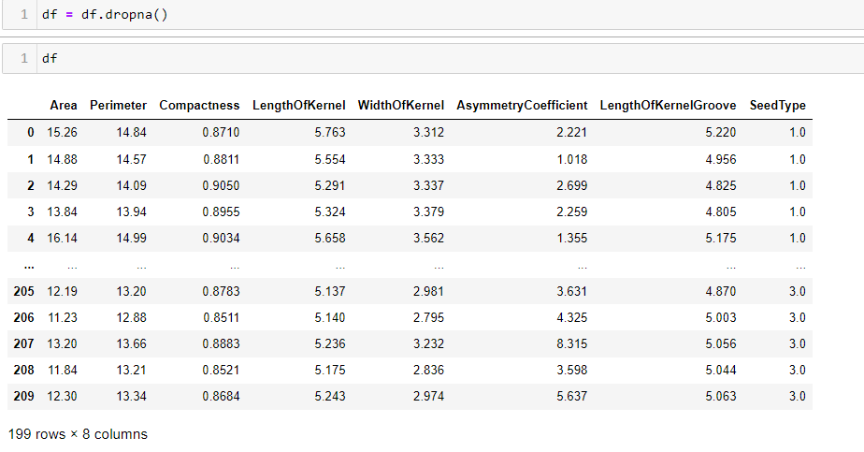
1.3 Deal with missing data
After cleaning missing data, the dataset convert to 199 rows and 8 columns.

Slide 8

2
Visualizing Data Analysis

Slide 9
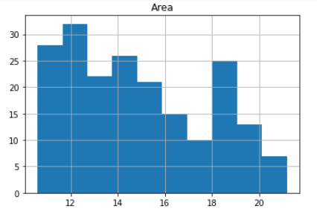
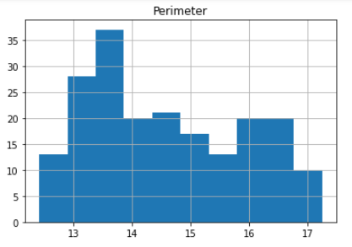
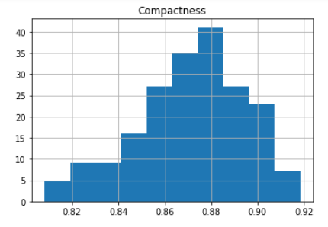
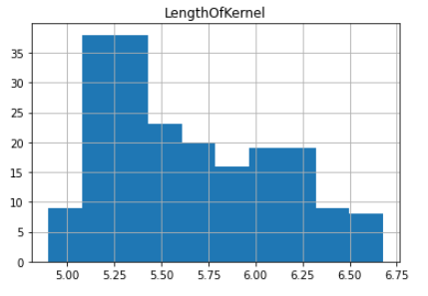
2.1 Plot the distribution of each feature

Slide 10
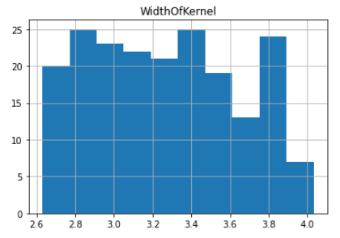
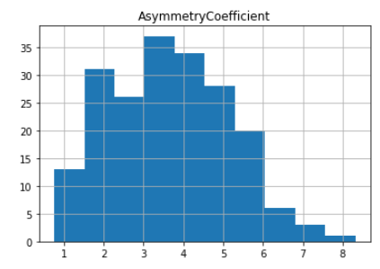
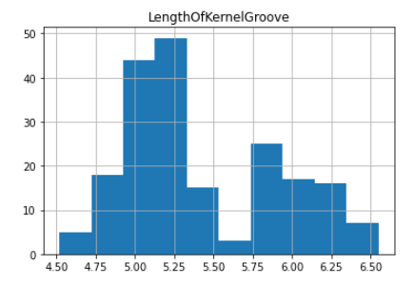
2.1 Plot the distribution of each feature

Slide 11
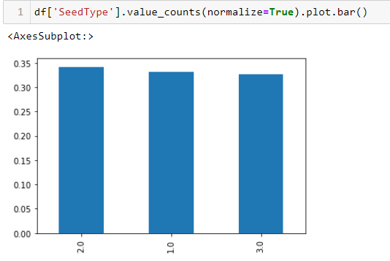
Seeds categories
We can see that we have about even number of seeds for each type. This is good because if one or two categories was severely underrepresented or, in contrast, overrepresentation in the data, then it may cause our model to be biased and/or perform poorly on some or all of the test data.

Slide 12

3
Exploratory Data Analysis

Slide 13
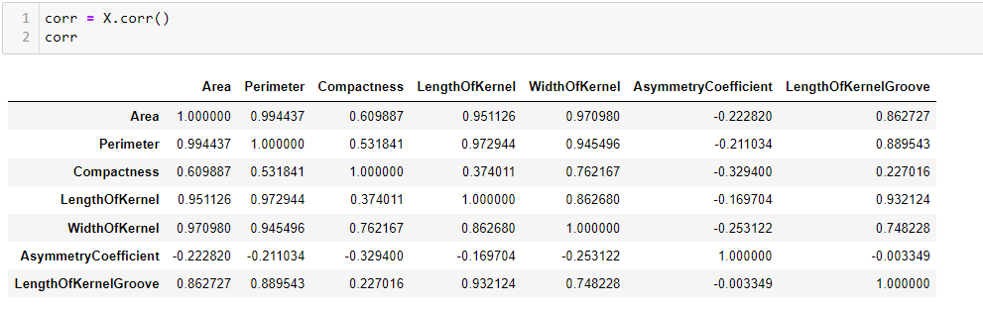
3.1 Get correlation matrix

Slide 14
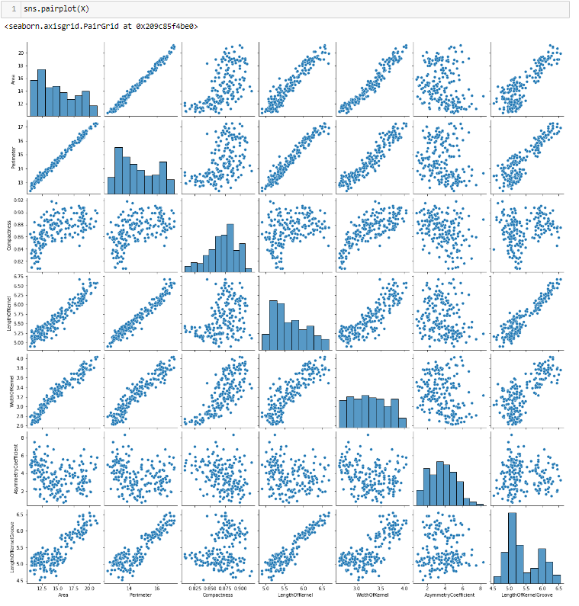
3.1 Get correlation matrix

Slide 15
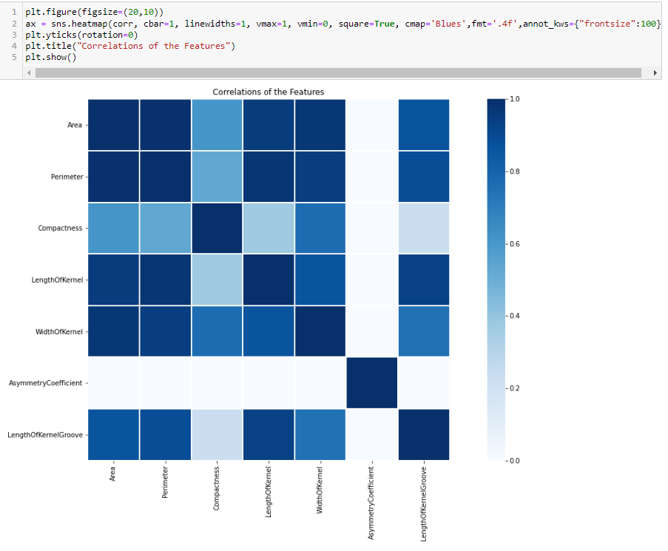
3.2 Display a heat map

Slide 16
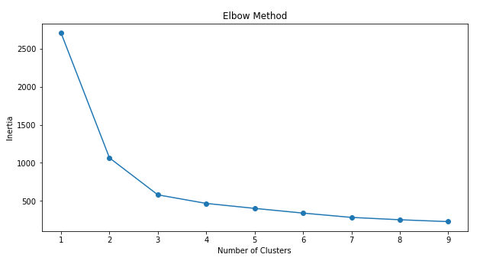
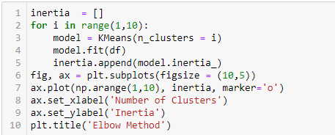
3.3 Kmeans clustering
3.3.1 Kmeans model

Slide 17
3.3.2 Split data
Use sklearn.model_selection.train_test_split function to split the data frame to X_train, x_test, Y_train, y_test. X_train is 80% of observation randomly chosen. X_test is the rest 20%

Slide 18
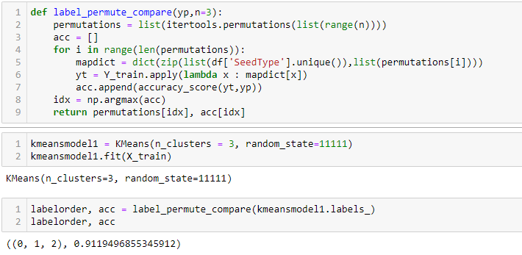
3.3.3 Calculate accuracy for original data

Slide 19
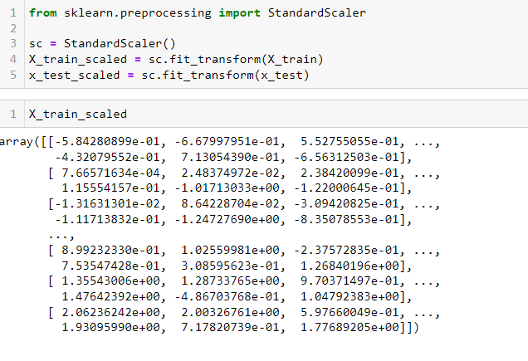
3.3.4 Standardize data

Slide 20
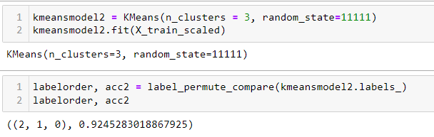
3.3.5 Calculate accuracy for standardized data

Slide 21
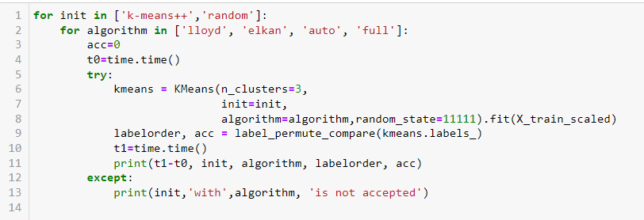
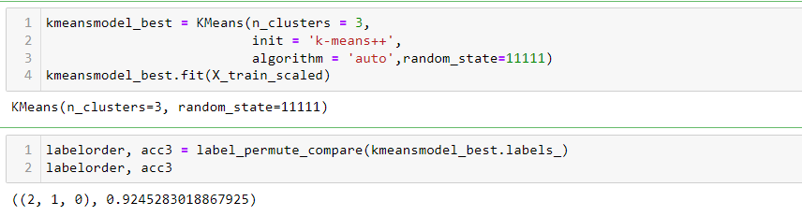
3.3.6 Optimize the model

Slide 22
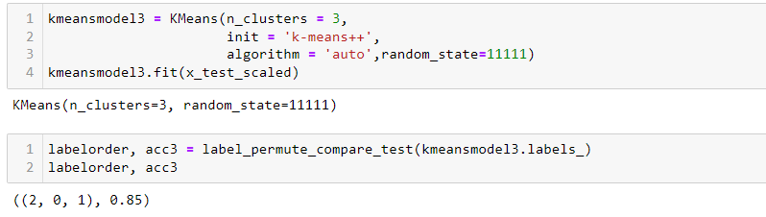
3.3.7 Apply kmeans model in the testing dataset

Slide 23
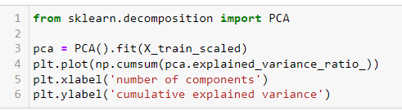
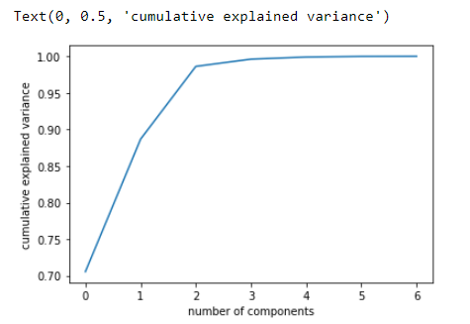
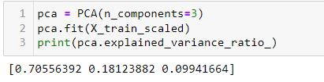
3.4 PCA model

Slide 24
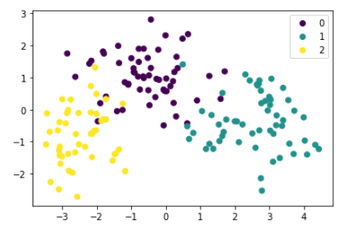
3.4 PCA model

Slide 25
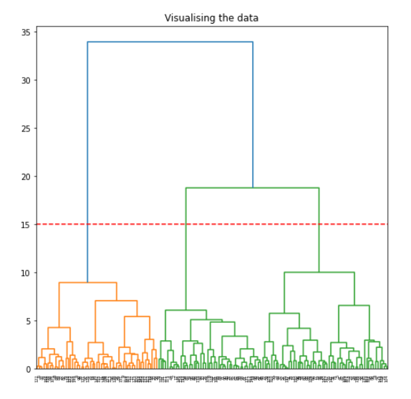
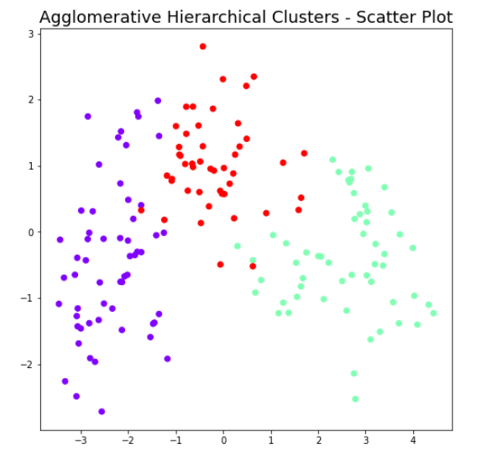
3.5 Hierarchical clustering

Slide 26

4
Results and Analysis

Slide 27
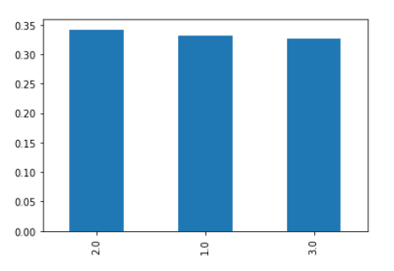
1. Inspect the null values and deal with missing data
2. Exploratory data analysis
?

Slide 28
3. Three different unsupervised methods to analyze
(1) Kmeans clustering
(2) PCA model
(3) Hierarchical clustering
?

Slide 29
5
Discussion

Slide 30
To Do
Analyze more relatively data
Try different type of linkage in Hierachical clustering

Slide 31
THANKS

